Slide 1


Part 1: Fundamentals
Notes:
https://www.youtube.com/watch?v=t2aKpgYErsk

Slide 2
What We Will Cover
Docker Overview
Docker Architecture

Slide 3

Docker Overview

Slide 4
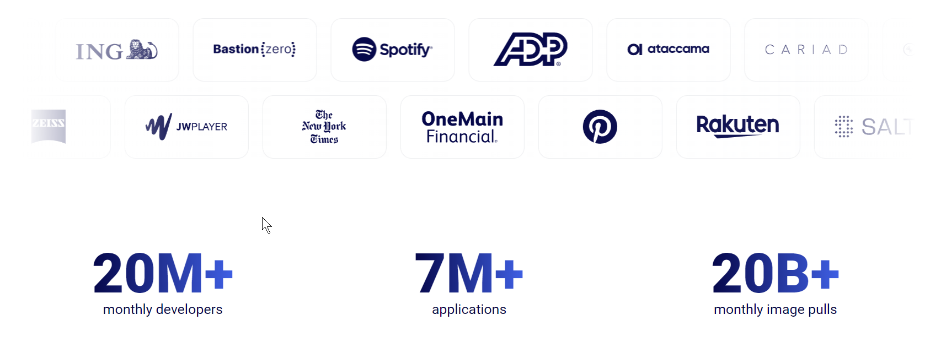
Why Docker?

Slide 5
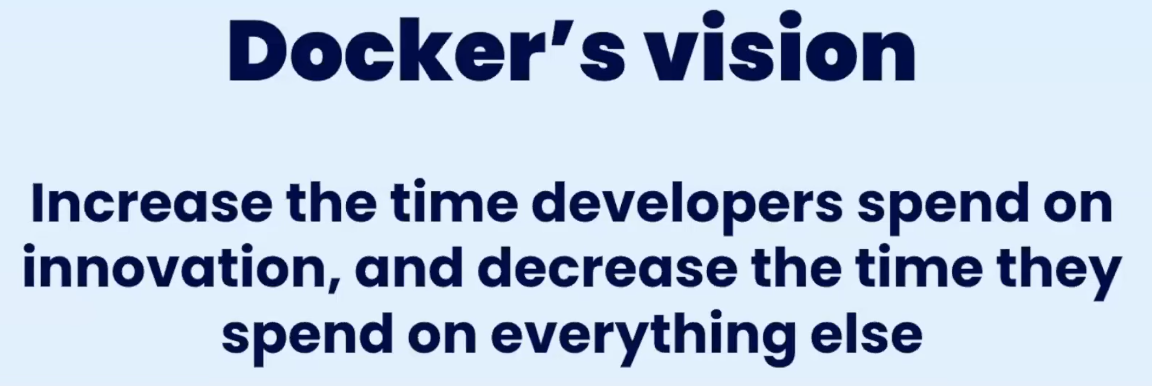
Notes:
https://www.youtube.com/watch?v=t2aKpgYErsk

Slide 6
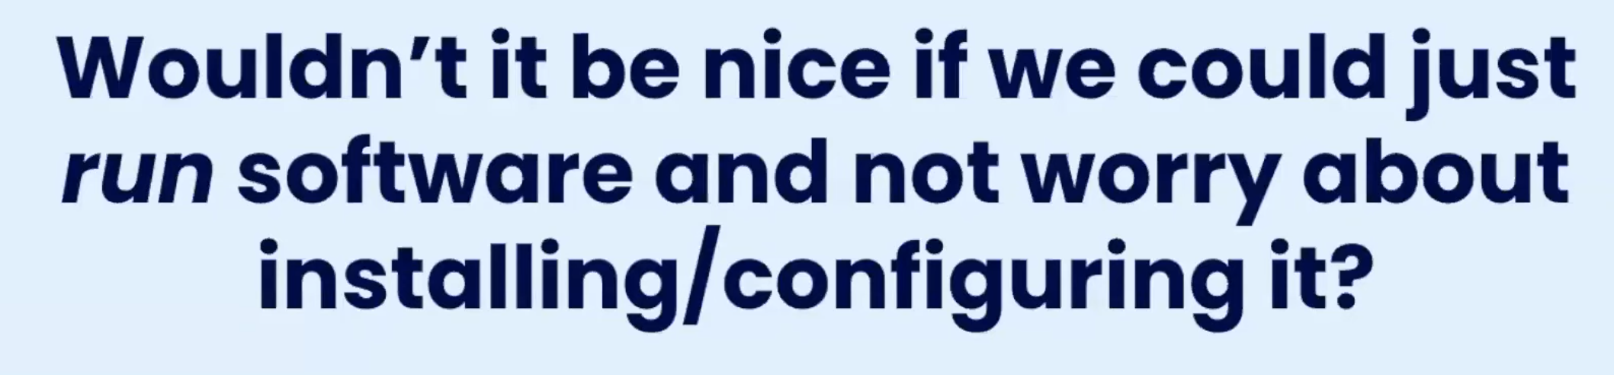
Notes:
https://www.youtube.com/watch?v=t2aKpgYErsk

Slide 7
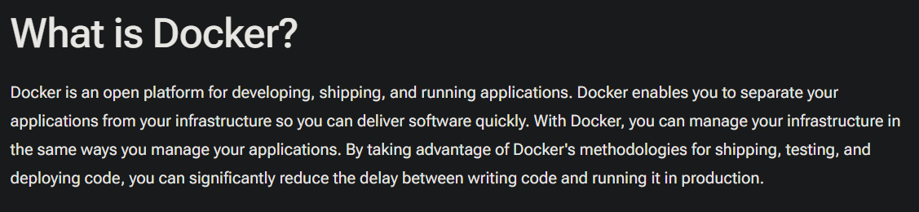
Notes:
https://docs.docker.com/get-started/docker-overview/

Slide 8
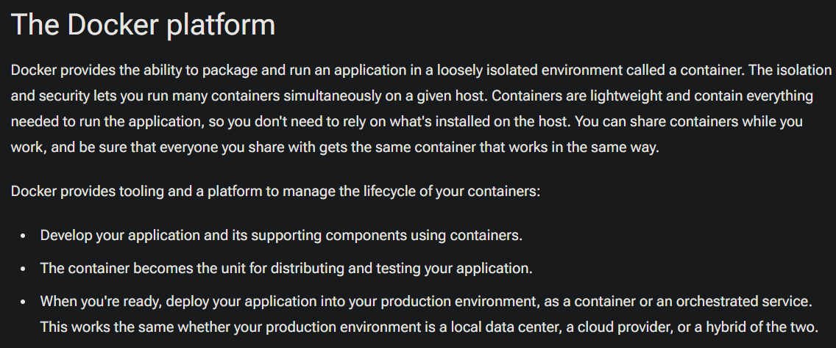
Notes:
https://docs.docker.com/get-started/docker-overview/

Slide 9
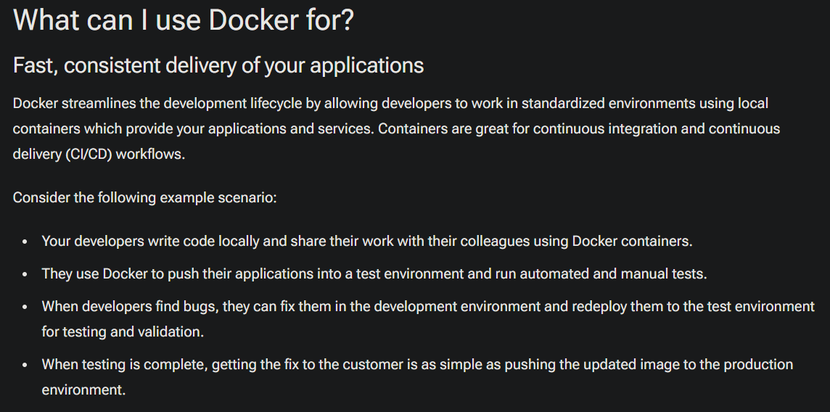
Notes:
https://docs.docker.com/get-started/docker-overview/

Slide 10
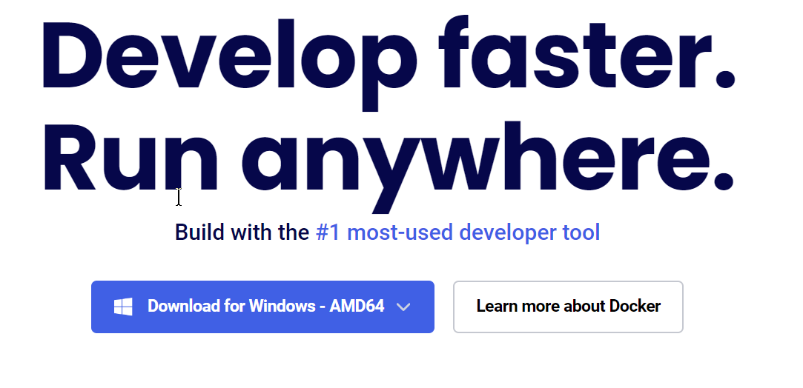
Demo: Installing Desktop
Notes:
https://www.docker.com/

Slide 11
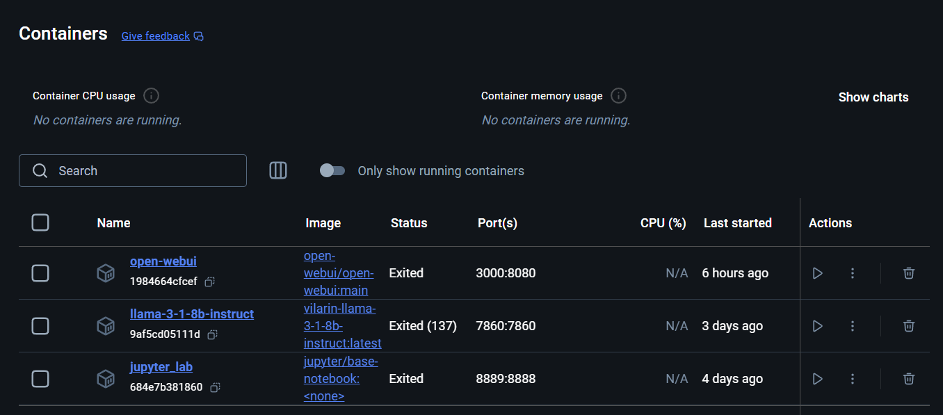
Demo: Docker Desktop

Slide 12



Notes:
https://www.youtube.com/channel/UC35ZpwldGw7ZJ5R-2sLijzw

Slide 13

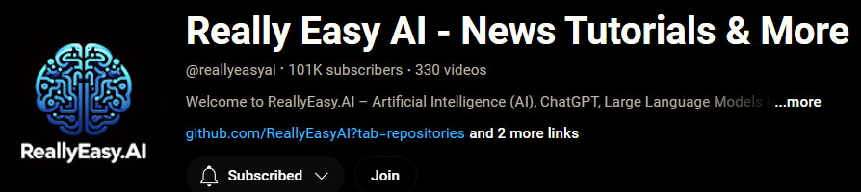
Become a Member!
Notes:
https://www.youtube.com/channel/UC35ZpwldGw7ZJ5R-2sLijzw/join

Slide 14

https://www.youtube.com/@AINewsFresh

Slide 15
Docker Architecture

Slide 16
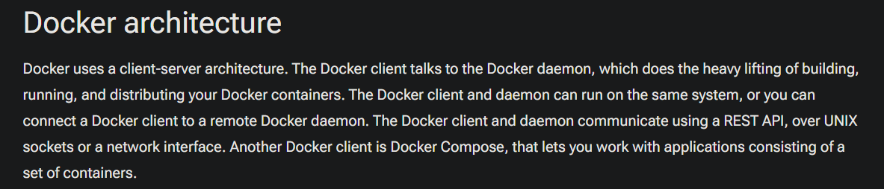
Notes:
https://docs.docker.com/get-started/docker-overview/

Slide 17
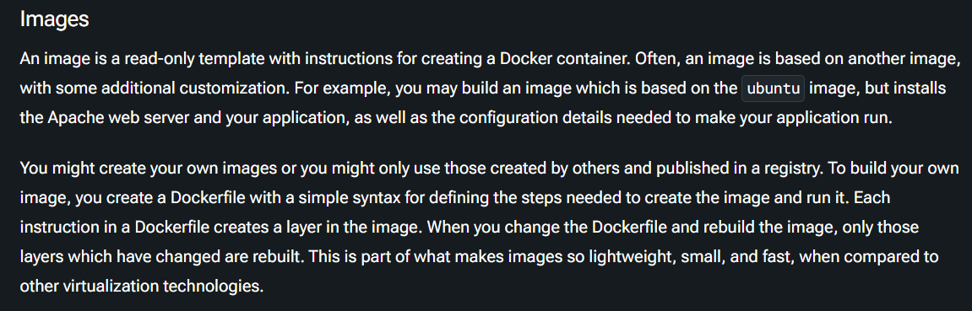
Notes:
https://docs.docker.com/get-started/docker-overview/

Slide 18
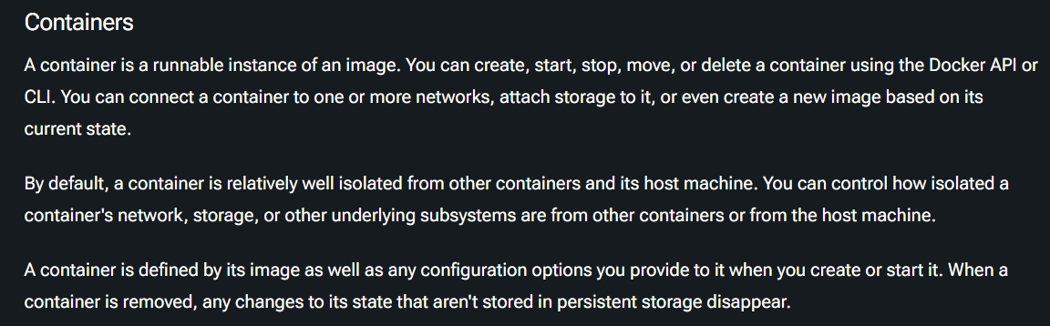
Notes:
https://docs.docker.com/get-started/docker-overview/

Slide 19
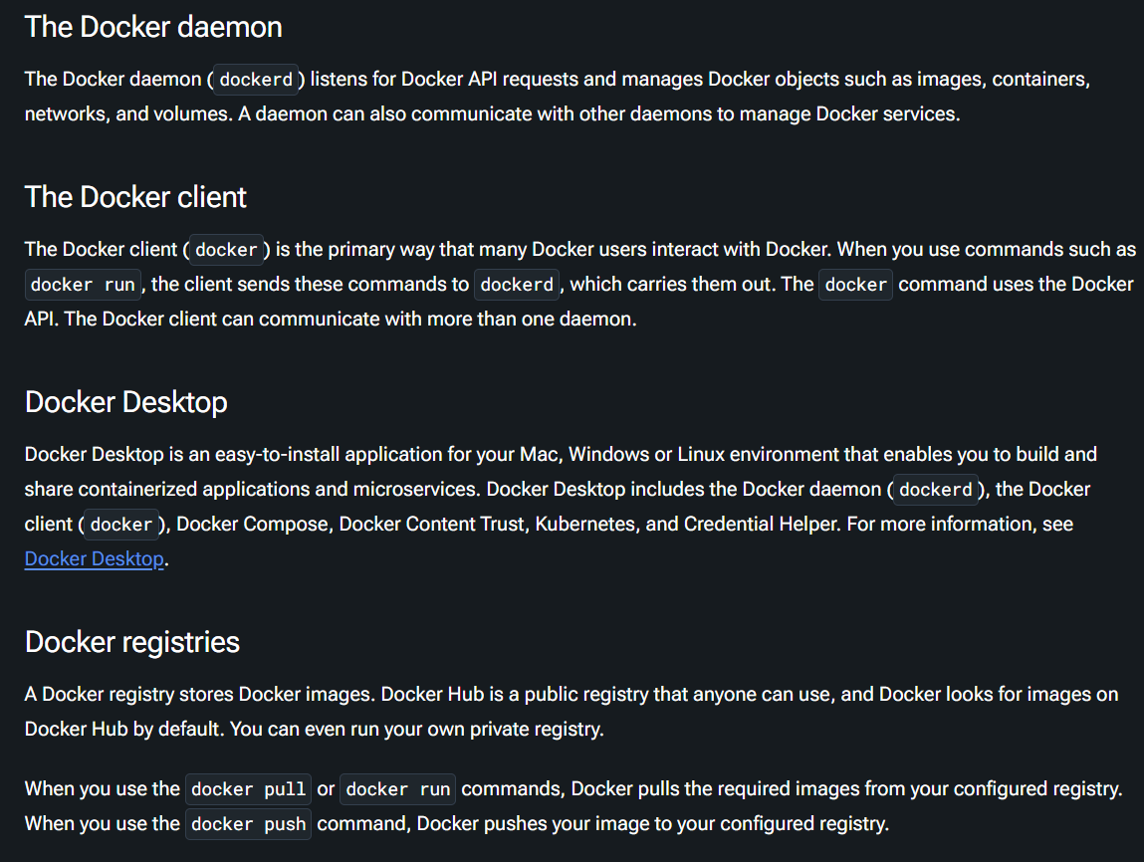
Notes:
https://docs.docker.com/get-started/docker-overview/

Slide 20
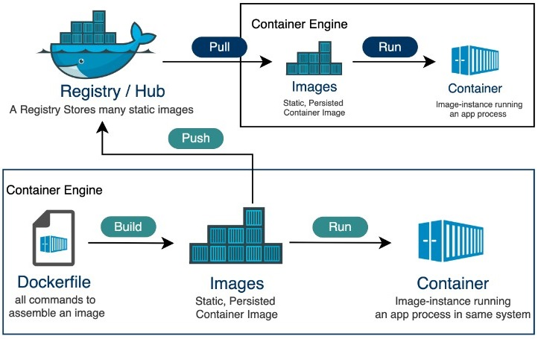
Notes:
https://www.tutorialspoint.com/docker/docker_hub.htm

Slide 21
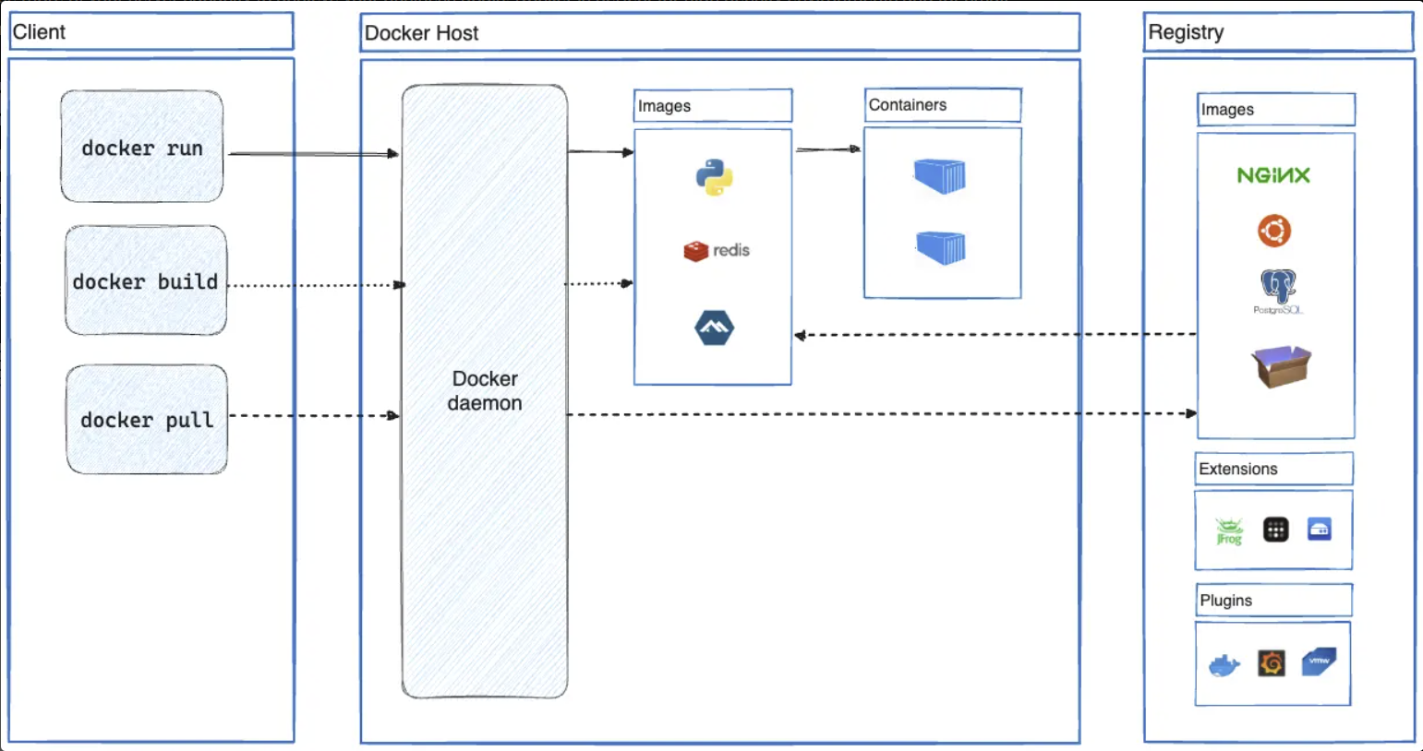
Notes:
https://docs.docker.com/get-started/docker-overview/

Slide 22
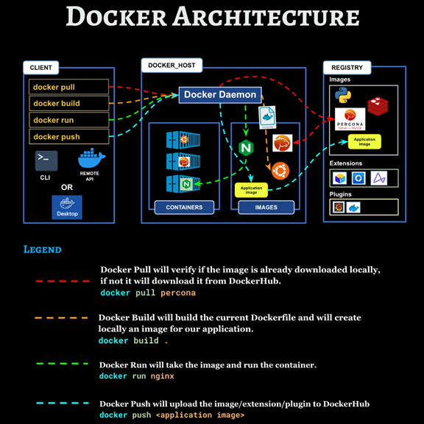
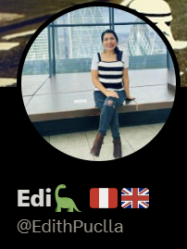
Notes:
https://x.com/EdithPuclla/status/1581353001335541760

Slide 23
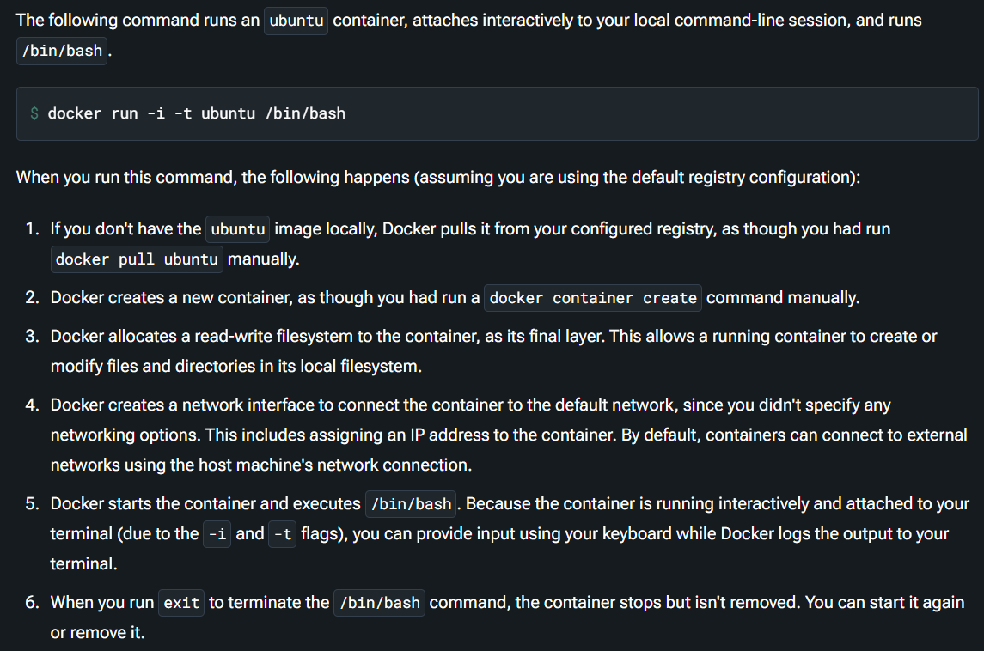
Demo: Quick Python Pull
Notes:
docker run -it --name my-python python /bin/bash
python --version
pip install pyfiglet && clear && python3 -c 'import pyfiglet; print(pyfiglet.figlet_format("Hello YouTube!"))'
https://docs.docker.com/get-started/docker-overview/

Slide 24


